Slide 1
2024
Poll Worker Training
Provided by the:
State Board of Election Commissioners
501 Woodlane – Suite 122 South
Little Rock, AR 72201
501-682-1834
1-800-411-6996

Slide 2
You’re the Teacher!
Think about how you will present this material to your county’s poll workers
Use the Training Guide:
Have the poll workers follow along in guide
Any changes to this presentation need to be approved by the SBEC
Other than the inclusion of local procedures

Slide 3
Agenda
General Session
Designed for Clerks checking in voters or assisting in the operation of voting equipment
Advanced Session
Designed for poll workers in supervisor positions or poll workers responsible for opening and closing the poll and provisional voting
Part Three
Absentee Ballot Clerks
Notes:
During voting hours:
Processing voters
Primary & Runoff points of emphasis
Fail-Safe voting, etc.
Assisting voters
Provisional voting
Poll watchers
Electioneering
Spoiled and abandoned ballots

Slide 4
Poll Worker Qualifications
MUST NOT
MUST
Be guilty of violating any criminal election law
Be a candidate (except county committee) while serving
Be a paid employee of any political party or of any candidate running for any office on the county’s ballot
Be employed by a company doing business with the CBEC
Be married or related to a candidate running for office while serving, if an objection is made
Be a county political party chairman or the spouse of a chairman, if an objection is made
Be a CBEC member or the spouse of a CBEC member, if an objection is made
Be a qualified elector*
Be able to read & write English
Be a resident of the county
Take oath prior to serving in your official capacity
Attend mandatory training conducted by SBEC (or designated trainer)
IF YOU BELIEVE YOU MAY NOT MEET ANY OF THESE REQUIREMENTS, PLEASE LET THE PRESENTER KNOW NOW OR AT A BREAK.

Slide 5
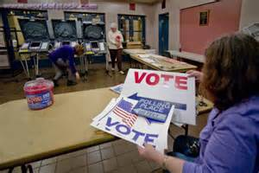
Before Opening the Polls
This section provides general information for all poll workers while more detailed instructions for opening the poll will be provided in the afternoon session.
Specifically, we’ll cover:
Addressing problems
Administering the oath;
Arranging the poll;
Locating supplies, postings, and forms.

Slide 6
What to Do If… - P.3
If you arrive and have issues you cannot address, please contact your County Election Officials:
CBEC Members
Election Coordinator
County Clerk

Slide 7
Before Any Official Duties - P.5
All poll workers are required to take an Oath before they begin serving in your office
The Oath should be stated aloud to another poll worker
You MUST sign under the Oath
If you do not have four poll workers, one of which is a Poll Judge, then contact the CBEC immediately P.3

Slide 8
Before Opening the Polls
Ensure Your Poll Is Accessible to Disabled Voters
Consult local instruction from your CBEC
Arrange the poll
Ensure privacy and accessibility
No one within 6 feet of machine
Poll Workers should provide privacy to
voters when voting and casting ballots
“The machine shall be placed so that no person can see or determine how the voter casts his or her vote.” A.C.A. §7-5-521
“Each voter shall be provided the privacy to mark his or her ballot. Privacy shall be provided by the poll workers at each polling site or by the county clerk, if the county clerk conducts early voting, to ensure that a voter desiring privacy is not singled out.” A.C.A §7-5-310
Notes:
Before opening the poll, poll workers must verify that a voter can walk up to each machine, vote, and exit the voting area without being able to see the screen of any other machines.
Voters must also be six feet away from all other machines; however, the fact the machines are six feet apart does not necessarily make the poll arrangement lawful.
Each voter must be able to cast his or her vote in private.
The exterior of all voting machines must also be in plain view of the poll workers.

Slide 9
Before Opening the Polls
Activate voting equipment
At least ONE accessible voting machine per poll is required
Generate zero tape(s)
ALL poll workers must sign the zero tape(s)
Post the zero tape(s) on a publicly viewable space
Inspect and locate supplies
Post required information
Notice of Election – Sample Ballots – Voting Instructions – List of Registered Voters by Precinct – Poll Watcher Rights and Responsibilities, etc.
Locate forms
PVR List – Lists of Voters – Notice to Provisional Voters – Assisting Voters – Change in Polling Site Authorization – Voter Machine Complaint, etc.
Notes:
a single tape showing the serial # and that the candidate and question counters = 0 for each machine is ok

Slide 10
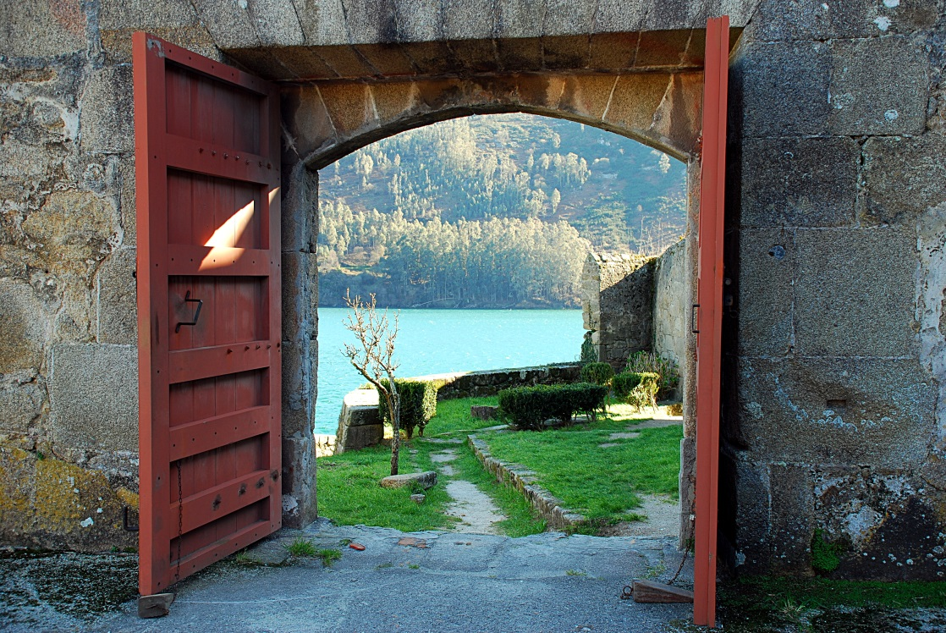
Open the Poll
Open promptly at 7:30am
Poll Workers should not vote before 7:30
Keep open continuously until 7:30pm

Slide 11
WHAT IF – Problems Opening the Poll
What if the Poll Tablets cannot be connected to the internet?
Open the poll to voting at 7:30am
Use the tablets in offline mode
Report the problem immediately to the CBEC or designated contact
What if the Poll Tablets fail entirely?
Open the poll to voting at 7:30am
Open the poll using the paper backups, if available
IF no PVR List is available, check in voters by calling the county clerk’s office
Report the problem immediately to the CBEC or designated contact

Slide 12
WHAT IF – Problems Opening the Poll
What if the DS200 Tabulator fails or isn’t available at 7:30am but the ballot markers are working?
Open the poll to voting at 7:30am
Place voted ballots in the emergency slot until the tabulator is operational
Report the problem immediately to the CBEC or designated contact

Slide 13
WHAT IF – Problems Opening the Poll
What if the ballot markers are not functioning?
Open the poll to voting at 7:30am
Allow voters to vote on any provisional paper ballots that are available and cast them in the emergency slot of the DS 200
Report the problem immediately to the CBEC or designated contact
If you cannot reach the county election officials, call the SBEC or Secretary of State!
Our phone number is located on the PW Guide and Checklist

Slide 14
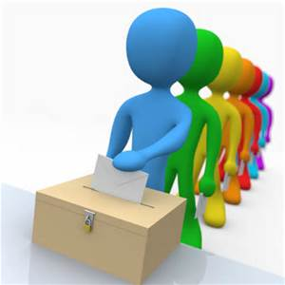
During Voting Hours
This section is intended for poll workers who process voters and contains general information that all poll workers should familiarize themselves with.
We’ll talk about the steps for processing voters and what to expect on Election Day.

Slide 15
Video 1 – Voting Process
Stand By……. Technical Difficulties ……

Slide 16
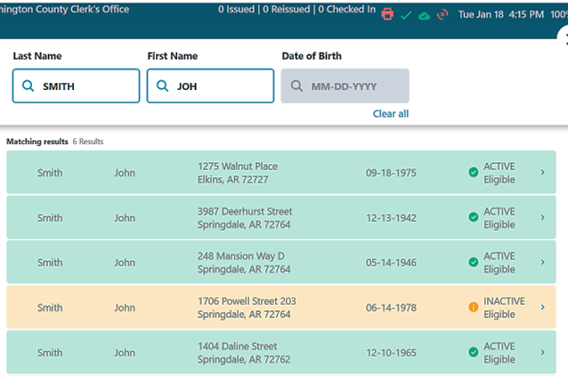
How to Process Voters into the Poll
Step 1 p.23
Step 1: Ask the voter to verify his or her voter registration with a photo ID.
Do Not ask for a specific form of ID (i.e., Driver’s license)
If the Voter shows an Arkansas Driver’s License, ask the Voter if you can scan their DL to go straight to the Voter information on the Poll Book
If the Voter does not show a Driver’s
License or refuses to allow it to be
scanned – Search by entering the
Last & First Name
All voters must complete this process
even if you know them.

Slide 17
Requirements for the Photo ID
Step 1
Voters must verify their registration by showing a document or identification card that shows the name and photograph of the person to whom it was issued and is issued by:
The United States,
The State of Arkansas,
Any Postsecondary Educational Institution accredited in the State, or Trade School, or
The County Clerk
If the Photo ID displays an expiration date, it must either be current or not expired more than four years before the date of the election in which the person seeks to vote

Slide 18
Requirements for the Photo ID
Step 1 (Supplemental) p.23
Examples of acceptable Voter IDs include (but are not limited to):
An Arkansas driver’s license;
A concealed carry handgun license;
A US passport;
An employee badge or ID document issued by the State of Arkansas, the federal government, or a postsecondary educational institution located in Arkansas; or Trade School
A US military ID document;
A student ID card issued by a postsecondary educational institution or trade school;
A public assistance ID card; or
A voter ID card issued by the county clerk.
EXCEPTION: Voters who live in a long-term or residential care facility licensed by the state may show documentation from the administrator (Documentation of Residency) attesting that the voter is a resident of the facility

Slide 20
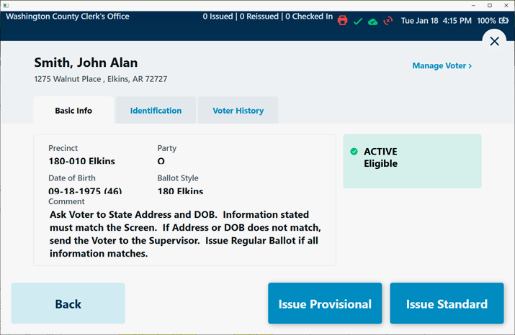
How to Process Voters into the Poll
Step 2-3 p.23
Step 2: Ask the voter to state his or her name aloud
If multiple voters have the same name, it may be necessary to enter their date of birth also
Step 3: Ask the voter to state his or her address and date of birth aloud
Poll Watchers must be able to hear the information and have the opportunity to object
DO NOT use a Photo ID to
obtain this information

Slide 21
How to Verify the Name Step 4 P.23
Step 4: Verify that the information given by the voter is the same as the information in the PVR List (tablet)
If the voter’s name varies slightly, but the name is comparable, then move forward
Abby vs. Abbigail
Bill vs. William
If the voter’s name has changed due to marriage, divorce, adoption, etc., then the voter must complete a Voter Registration Application (Votes a Regular Ballot)

Slide 22
How to Verify the DOB Step 4 (Supplemental) P.23
If the date of birth is incorrect in the Poll Book, but the voter asserts this is a clerical error, then continue with the Photo ID process
Refer to Poll Judge (p. 25)
Provides Photo ID (Showing the DOB stated by the voter) – Have voter complete a Voter Registration Application and issue a Regular Ballot
Does NOT Provide Photo ID – Have the voter vote a Provisional Ballot

Slide 23
How to Verify the Address Step 4 (Supplemental) P.23
If the address stated by the voter differs from the address in the PVR List (tablet), the matter should be referred to the Poll Judge.
This process will be addressed in more detail in the afternoon session.

Slide 24
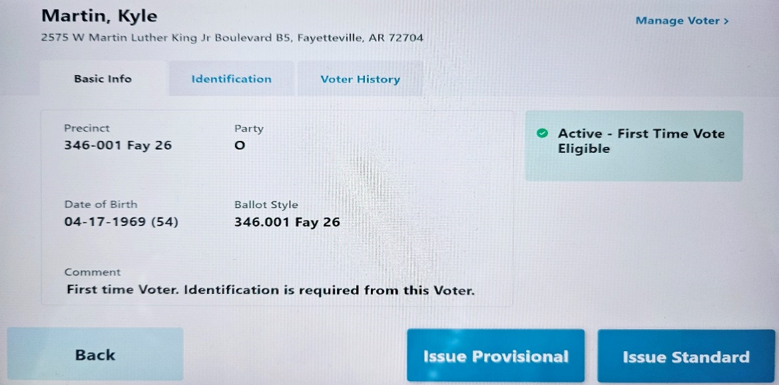
How to Process Voters into the Poll Step 5 - P.23
Check to see if the voter is a “flagged” first time voter (p.26)
These first-time voters have Special ID Requirements:
Must show a CURRENT Driver License - NOT EXPIRED
OR
Must show one of the following: Current utility bill, bank statement, government check, paycheck, or other government document that shows:
Voter's Name and Voting Address

Slide 25
How to Process Voters Into the Poll
Step 6 - p.23
Step 6: Use the Photo ID to:
Compare the photo on the ID to the person standing in front of you
AND
Compare the name on the ID to the name in the PVR List (tablet)
DO NOT compare the address on the ID to the address in the PVR List

Slide 26
Assessing Validity of ID Step 6 (Supplemental) P.23
The poll worker must:
Verify that the name on the ID is consistent with the name in the Poll Book while allowing for abbreviations, nicknames, and name changes;
If the name is consistent, compare the photograph to the voter to determine whether the voter is the person depicted in the photograph while considering changes in hair color, glasses, facial hair, cosmetics, weight, age, injury, and other physical characteristics;
If the poll worker is satisfied that the voter is the person depicted in the photograph and the name is consistent with the name in the Poll Book, then issue the voter a regular ballot;
If the voter’s name has changed or is different from the name in the Poll Book or the name as stated by the voter, but the poll worker is satisfied that the voter is the person depicted in the photograph, issue the person a regular ballot after the voter completes a voter registration application for the purpose of updating the voter’s information.

Slide 27
Assessing Validity of ID Step 6 (Supplemental) P.23
If the poll worker determines that the ID does not depict the voter, or the name is not similar, the voter is referred to the Election Judge of the poll
The Election Judge shall:
Compare the name of the voter to the PVR
Compare the photo to the voter
The Election Judge shall resolve any marginal cases in favor of the voter
If the Election Judge determines that the ID does not depict the voter then the voter is offered a Provisional Ballot

Slide 28
How to Process Voters into the Poll Step 7 - P.24
Pass the ID to the poll worker keeping the list of voters
Uses to ensure correct spelling of name
Add name to the numbered List of Voters form
Return ID to voter

Slide 29
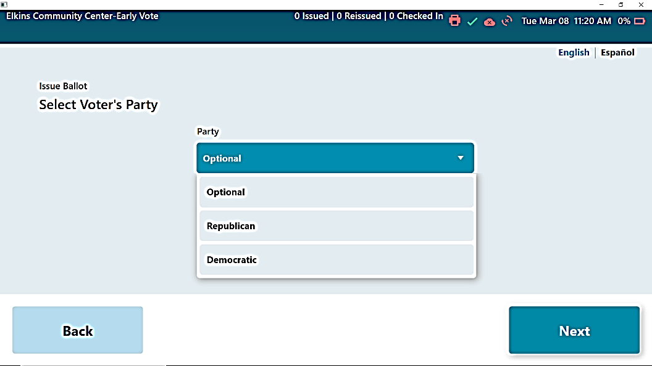
How to Process Voters into the Poll Step 8 - P.24
For Primary Elections, ask the voter “which party primary he or she wishes to vote in”
Select the appropriate party primary or nonpartisan election

Slide 30
How to Process Voters into the Poll Step 9a-b - P.24
For Primary Runoff Elections ONLY:
Check the PVR List to ensure voters do not crossover
Crossover voting occurs when a voter in one primary votes in another party’s primary runoff
Crossover voting is a CRIME

Slide 31
Crossover Voting is a Crime
Voters:
Poll Workers:
It is a misdemeanor, punishable by
up to one year incarceration and a
fine of up to $2,500, for a person to
vote in the preferential primary of
one political party and the general
primary (runoff) of another.
Example: A voter who voted in
the Republican primary
election cannot then
vote in the Democratic party’s
runoff election.
It is a felony, punishable by up to six years incarceration and a fine of up to $10,000, for a poll worker to knowingly permit a person to vote other than his or her legal ballot or fraudulently permit a person to vote illegally.

Slide 32
How to Process Voters into the Poll Step 10-11 - P.24
Step 10: Insert the blank Ballot into the printer
Step 11: Select the “ID Provided/Issue Regular Ballot” box on the PVR List
Notes:
What have you done so far?
Compared the Stated Name, Address, and DOB to this page
Compared the Name on the ID to this page
Compared the picture on the ID to the voter standing before you

Slide 33
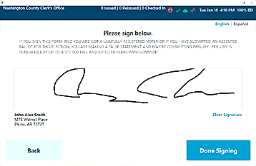
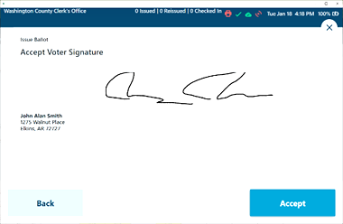
How to Process Voters into the Poll Step 12-13 - P.24
Step 12: Allow the voter to sign
The voter may choose to re-sign if the voter is unsatisfied with the current signature
Select “Done Signing”
Step 13: Click “Accept”
DO NOT reject a voter based on a comparison of signature if your poll book displays the voter’s signature at this point

Slide 34
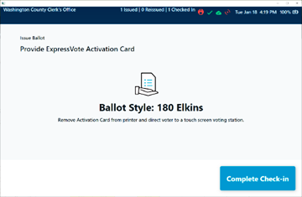
How to Process Voters into the Poll Step 14-15 - P.24
Step 14: After the ballot prints select “Complete Check In”
Step 15: Provide the ballot to the voter and instruct them where to go cast the ballot

Slide 35
Fail-safe Voting (Pages 25-26 of training guide)
Steps to take when the Voter’s Statements do not match the PVR List
Name provided differs with PVR List
DOB provided differs with PVR List
Address provided differs with PVR List
Address is not within precinct
Voter registration cannot be verified
PVR notations:
Voted Absentee
Voted Early

Slide 36
Fail-safe Voting
If a person attempts to vote and asserts, they are eligible to vote in the election then one of three things must happen:
The voter votes a Regular Ballot;
The voter votes a Provisional Ballot; or
If you do not have vote centers, the voter is sent to another poll that has the correct ballot style available.

Slide 37
Voter States an Address that does not Compare (Fail-safe Voting) P.25-26
Situation
How To Proceed
Voter states their address
The poll workers compare the stated address to the PVR List
Address in the PVR List differs from the stated address
Turn the voter over to the Poll Judge
DO NOT proceed unless you or your Poll Judge have called the County Clerk
ALWAYS!
Follow instructions of your Poll Judge and/or the County Clerk
Notes:
What if in the County?
Congressional District Issue

Slide 38
Voter States an Address that Does Not Compare (Fail-safe Voting) P.25-26
New address in county and NOT assigned to this polling site
NON - VOTE CENTER COUNTY
If the address stated by the voter is in the same county (and Congressional District) and the voters at the new address also vote at this poll:
Votes a regular ballot
Must be sent to the new address polling site with “Change in Polling Site Authorization Form”
Voter MUST complete and return an updated voter registration application
Must be instructed on how to find the new poll
WHAT IF THE ADDRESS COULD NOT BE LOCATED IN THE COUNTY – Vote Provisional
Notes:
Only 5 Counties Are in two Congressional Districts
Newton
Crawford
Sabastian
Searcy
Jefferson

Slide 39
Voter not In the PVR List (Fail-safe Voting) P.26
Situation
How To Proceed
Voter states their name, address, and DOB
The poll workers cannot find the voter in the PVR List
Voter believes he or she is registered
Turn the voter over to the Poll Judge
DO NOT proceed unless you or your Poll Judge have called the County Clerk
ALWAYS!
Follow instructions of your Poll Judge and/or the County Clerk
Notes:
What if in the County?
Congressional District Issue

Slide 40
Voter States an Address that does not Compare (Fail-safe Voting) P.25-26
Voter Not Found in PVR List
If the County Clerk is able to find the voter in the PVR List:
Votes a regular ballot
IF address is assigned to another poll, voter is given the “Change in Polling Site Authorization Form”
Voter MUST complete and return an updated voter registration application

Slide 41
Voter States an Address that does not Compare (Fail-safe Voting) P.25-26
Voter Not Found in PVR List
If the County Clerk is NOT able to find the voter in the PVR List:
The voter is required to vote a provisional ballot
The County Clerk will identify which ballot style is assigned to the precinct part where the address stated by the voter is located
Voter MUST complete and return an updated voter registration application

Slide 42
Voter Believes they have the Wrong Ballot (Fail-safe Voting) P.25-26
Situation
How To Proceed
Voter believes the ballot assigned in the PVR List does not contain the correct races or issues
Name, address, and DOB stated by the voter does compare to the information in the PVR List
Notify the voter that they may cast any other ballot available in the poll they believe is correct, but that they will have to vote provisionally
Also inform the voter that they will have to prove there is an error in the county records or the ballots in order for the vote to count
If necessary, send to the Poll Judge to vote a provisional ballot
Notes:
What if in the County?
Congressional District Issue

Slide 43
Voter Received an Absentee Ballot (Fail-safe Voting) P.26
If the PVR List indicates that a voter received an absentee ballot, then the voter is required to cast a provisional ballot
You should explain the situation to the voter and send them to the Poll Judge
If a voter received an absentee ballot, but did not return it, the provisional vote will count

Slide 44
Voter is Marked as Having Already Voted (Fail-safe Voting) P.26
If the PVR List indicates that voter has already voted (ballot issued) the voter still has the option to cast a provisional ballot if they assert, they have not actually voted
The County Election Commission will have to determine whether the voter is attempting to vote twice

Slide 45
Ineligible Voters (Fail-safe Voting) P.25-26
In some special elections or school elections not held with the primary or general elections, not all voters in the county are eligible to vote because the election does not affect the entire county
If the PVR List indicates that voter lives outside the area eligible to vote in the election, the voter still has the option to cast a provisional ballot if they believe they are qualified
The County Election Commission will have to determine whether the voter presenting is eligible to vote in this election

Slide 46
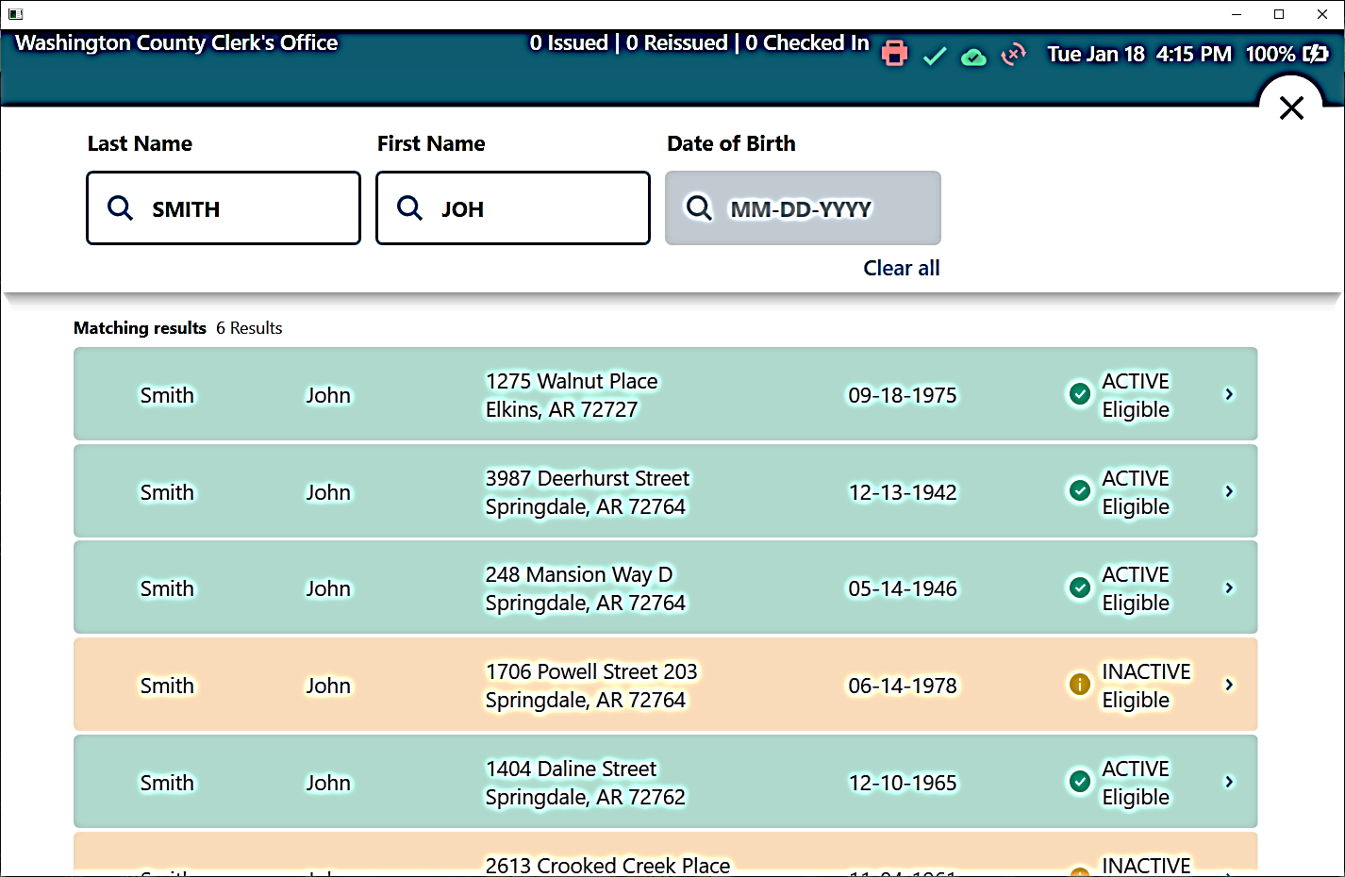
PVR List is Marked as “Inactive” (Fail-safe Voting) P.25-26
If you see this notation in the PVR List, you should ignore it
“Inactive” voters are ELIGIBLE and receive a regular ballot
YELLOW SHOWS INACTIVE VOTERS, BUT THESE VOTERS ARE STILL ELIGIBLE TO VOTE

Slide 47
Election Day Issues
Other situations you will need to be prepared to address on Election Day

Slide 48
Procedure for Assisting Voters P.36-37
Poll Worker Must List:
The name of each voter that is assisted; and
The names of the two poll workers who assist the voter
One to assist and one to observe (w/out comment or interpretation);
OR list the name and address of the person chosen by the voter to assist them

Slide 49
Limits on Assisting Voters P.36-37
TWO Poll Workers: May assist an unlimited number of voters
Must be accompanied by a second poll worker!
Third Parties: May assist up to six voters if:
Voter requests the assistance (not the 3rd party)
Candidates: May assist up to six blood relatives
Within two degrees of relationship
All Assistants: Required to ONLY mark the ballot as directed by the voters
Assistants who engage in electioneering should be documented (including their name) and removed

Slide 50
Important Reminders on Assistance to Voters
A voter must personally request help
Poll workers and poll watchers cannot suggest to a voter that he or she needs assistance
Poll workers can allow voters who are unable to stand in line, due to a disability, to move to the front of the line
Ballots cannot be taken out of the polling room during voting hours
A person assisting a voter cannot misrepresent the content of the ballot or change or mark the ballot, except as intended by voter

Slide 51
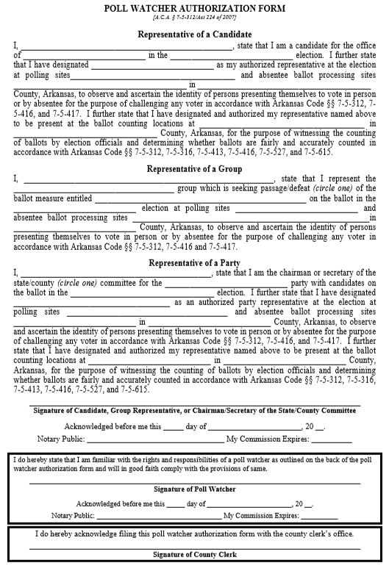
Poll Watchers and Vote Challenges P. 49-52
Poll Watchers are representatives of a candidate, party, or ballot issue group
Must take an on-line training course and provide the certification to the County Clerk
Must wear a name badge
Must provide a Poll Watcher Authorization Form
Poll Watcher Challenges
A poll watcher must notify a poll worker of the challenge before the voter signs the PVR List;
and
Complete the Challenged Ballot Form on the Provisional Voter Envelope

Slide 52
Poll Watchers Can…
Observe poll workers
Stand close enough to the place where voters check
in to vote so they can hear a voter’s name
Compile lists of voters
Challenge ballots before the voter signs the PVR List
and only on the grounds that:
The voter is not eligible to vote in the precinct; or
The voter has previously voted in that election
Call any perceived irregularity or election law violation
to the attention of the Poll Judge
Notes:
This includes not registered to vote…

Slide 53
Poll Watchers Cannot…
Be within 6 feet of any voting machines or voting
booths
Speak to voters
Try to influence voters:
Inside the poll; or
Inside the prohibited electioneering zones
Disrupt elections

Slide 54
Electioneering P.53, 55
What is Electioneering?
The display of, or audible dissemination of, information that advocates for or against any candidate, issue, or measure on a ballot
Prohibited within 100 feet
Prevention
Instruct any person entering the poll who is wearing or displaying campaign articles to remove them immediately
Check the poll frequently for campaign articles and remove them promptly
Monitor the electioneering prohibition zone periodically to ensure compliance
Post the Notice on Electioneering

Slide 55
Electioneering P.55
Displays of a candidate’s name, likeness, or logo;
Displays of a ballot measure's number, title, subject, or logo;
Audible dissemination of electioneering information;
Handing out literature on any candidate or issue on the ballot;
Soliciting signatures on any petition;
Soliciting contributions; or
Attempting to win votes by wearing or displaying buttons, hats, pencils, pens, shirts, signs, sticklers, or other articles designed to influence voters

Slide 56
Spoiled Ballots P.57
Stamp Cancelled on the ballot
Record the time and date
Print and sign name next to Cancelled Stamp
Place Ballot in the Spoiled Ballot Envelope
Fill out the Spoiled Ballot Affidavit (p. 59)
No more than 3 ballots may be issued to one voter
Election Judge will need to total and sign (Act 308)

Slide 57
Abandoned Ballots P.58
Abandoned in the Electronic Ballot Scanner
Abandoned Elsewhere in the Poll (not on scanner or marking device)
With Two Poll Workers Present:
Step 1: Override warning on the scanner
Step 2: Complete the process of casting the ballot
Step 3: Document the following on the Abandoned Ballot Log:
Name of the voter;
The time the ballot was found;
Names of the poll workers addressing the issue; and
All other circumstances surrounding the abandoned ballot.
The Abandoned Ballot Log is on Page 61 of your Manual
With Two Poll Workers Present:
Step 1: Write ABANDONED across the face of the ballot
Step 2: Place the ballot in a separate envelope
Step 3: Write Abandoned Ballot on the envelope
Step 4: Document all circumstances on the outside of the envelope
Step 5: Preserve abandoned ballot separately from other ballots
Ballots not found in the marking device or tabulator are NOT counted!

Slide 58
Abandoned Ballot Log - P.61

Slide 59
Conflict Resolution
When dealing with difficult voters or situations:
Remain calm and do not escalate the situation;
Turn the problem over to another poll worker, if necessary;
Call your CBEC or local law enforcement agency, if necessary;
Move any disturbance outside the immediate voting area, if possible; and
Document problems.

Slide 60
Candidates in the Poll
No candidates are allowed in person as poll watchers during voting on election day
Candidates may be present in person at an early voting poll:
Only for the purpose of observing
May not challenge voters
Must show ID
If the candidate observing early voting is also a public official:
The candidate may not wear anything that identifies him or her as a public official.
For example, a candidate cannot wear a:
Uniform;
Badge; or
Other apparel or equipment.

Slide 61
Advanced Procedures

Slide 62
Before Opening the Polls
This section is intended for poll workers responsible for managing the poll and includes topics that may not apply to every poll worker.
Specifically, we’ll cover:
Accounting for paper ballots;
Arranging the poll;
Activating voting equipment; and
Locating supplies, postings, and forms.

Slide 63
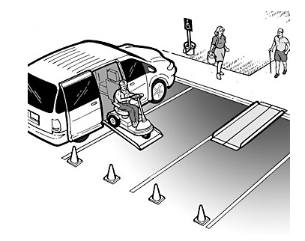
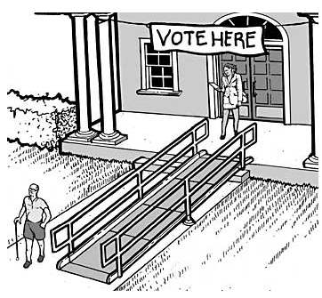
Accessible Polling Sites
Ensure poll is accessible for disabled voters
If your poll requires modifications, your county election officials will provide you with polling site specific instructions
These Modification May Address
Path Into the Poll
Temporary Ramps
Blocking Off Handicap Spaces
Signage
Door Handles (non-leaver)
Clip On Handles
Prop Open/Install Doorbell
Assign Poll Worker to Door
Mark obstructions for visually impaired voters
Ensure accessible voting equipment is available

Slide 64
Do You Have What You Need? P. 9-15
Equipment – Page 9
Other Supplies – Page 13 & 15
Tablets
Tablet Printers
WIFI/Hotspot
Tabulators
Marking Devices
Extension Cords
Ballots for Express Vote
If Paper Provisional Voting
Ballots
Booths
Stub Box
Secure Container for Envelopes
List of Voters
Provisional Ballot Envelops
Secrecy Envelopes
List of Provisional Voters Forms
See Page 12 for Additional Items
See Page 14 for List of Forms

Slide 65
Posting Required Information Required - P. 13
Notice of Election
Instructions on How to Vote (Two Copies)
Instructions on Voting Machine Operation
Voting Rights Laws (Provided by SOS)
State & Federal Election Laws (Provided by SOS)
List of Registered Voters by Precinct (Usually a bound volume)
Sample Ballots
Post on wall unless provided in bound or electronic form
Must be posted to SOS VoterView
Text of Ballot Measures
Poll Watchers Rights and Responsibilities
VOTE HERE Signs
Placed Near Each Main Driveway Entrance
Any Required Temporary ADA Signage
ZERO TAPES

Slide 66
Posting Required Information Recommended - P. 13
Notice of Electioneering
See Page 55
Warning for Incorrect Ballot Styles
See Page 17
Primary Runoff Only: Crossover Voting Warning
See Page 31
Mark 100 feet from primary entrance to the polling sight
To clearly mark the boundary for electioneering
Place trash can near the primary exterior entrance to allow voter to discard any campaign literature they were handed on the way into the poll

Slide 67
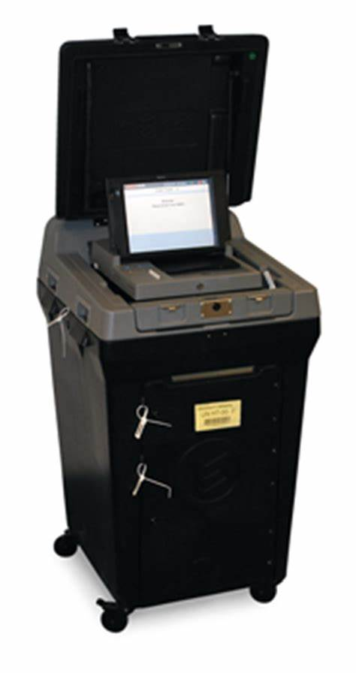
Activate the DS 200 Tabulator P. 10
Step 1: Unlock, raise the screen, and plug in the DS 200
Step 2: Enter the election code
Provided by your CBEC
Step 3: Select “Open Polls” after the Configuration Report runs
Step 4: Two zero tapes will run
Step 5: Sign all zero tapes and post one in a publicly viewable area
In view of voters’ present (i.e.: Early Voting)
Check to see that all doors are locked and sealed, including the door containing the thumb drive.

Slide 68
Activate the Marking Devices P. 9
Step 1: Turn the power on
Step 2: Lock security access door and place a seal on the door
Step 3: The screen loads automatically. This takes a few minutes.
Step 4: Enter the election code
Provided by your CBEC

Slide 69
Activate the Marking Devices P. 9
Step 5: Tap “Accept”
Step 6: Screen will say “Please Wait. Loading Election”
Step 7: Confirm the correct election on the upper left area of the voter screen
Step 8: The “To begin Voting, insert your card” screen appears.

Slide 70
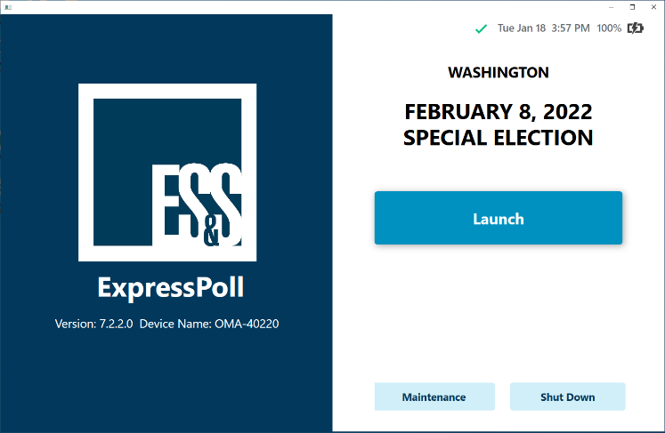
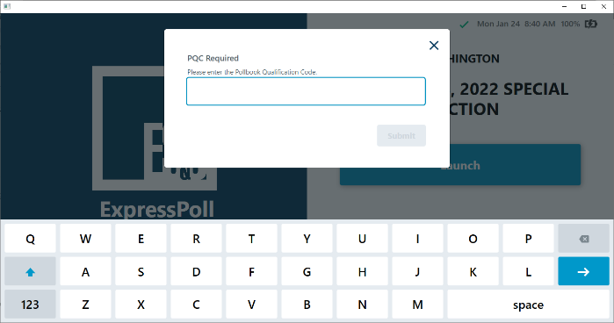
Activate the ExpressPoll Tablets P. 10
Step 1: Make sure the correct election is loaded
Step 2: Select “Launch”
Step 3: Enter the Pollbook Qualification Code (PQC)
Step 4: Select “Submit”
County Name
Election Date Election Name
PQC Required

Slide 71
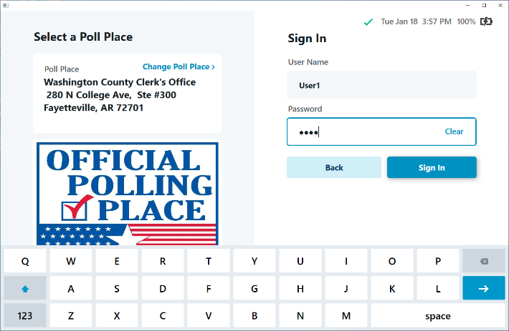
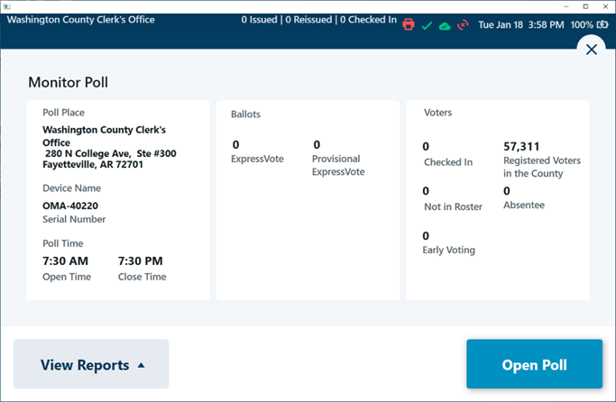
Activate the ExpressPoll Tablets P. 10
Step 5: Make sure the Polling Place is correct
Step 6: Enter Username
Step 7: Enter Password
Step 8: Select “Sign In”
Step 9: Select “Open Poll”
Polling Place Name and address
Polling Place Name and address

Slide 72
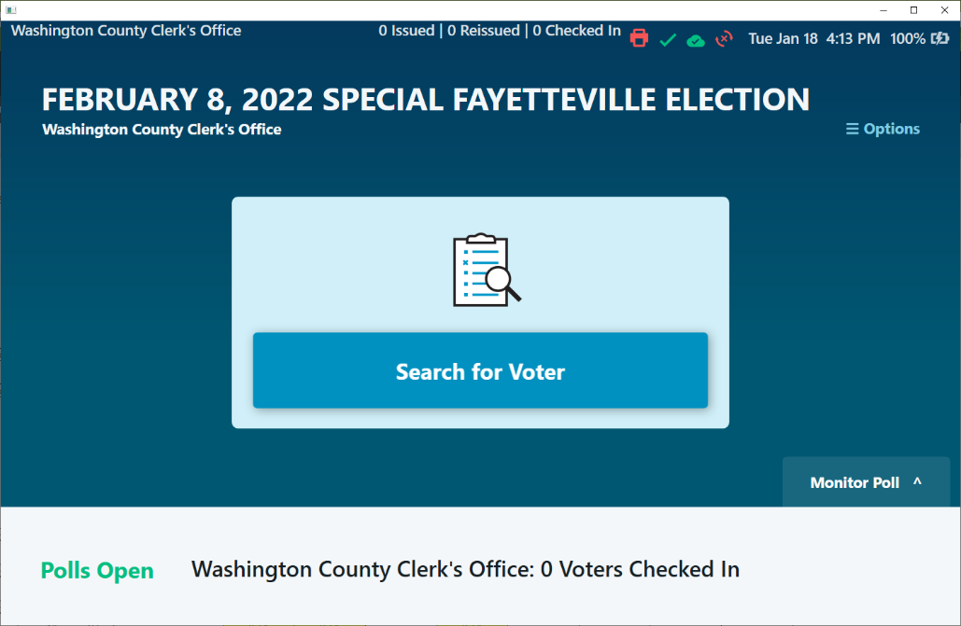
ExpressPoll Tablets
Make sure the number of ballots issued is ZERO
Verify you are connected to the WiFi
Green Check Mark and Green Cloud
Do not check in Voters until 7:30
Smart Update is no longer Required

Slide 73
Who Is Allowed in the Polls?
Election Officials
Poll Watchers
Voters
Persons in the care of voters who are not eligible to vote
Persons who are lawfully assisting a voter
Law enforcement and other emergency personnel
Monitors authorized by SBEC or federal agency
Persons with business in the building (go directly to and from
business)
Persons assisting the CBEC
Persons authorized by the SBEC or CBEC

Slide 74
Exit Polls
News organizations may conduct exit polls
CBEC has discretion on whether to allow
Exit polling is not considered electioneering
Allowed in 100’ prohibited electioneering zone
If CBEC allows exit pollsters, CBEC should let poll workers
know that the pollsters are coming
Exit pollsters:
May ask voters how they voted
Cannot disrupt the election
Do not have free reign in the poll
May be only where CBEC allows them to be in the poll

Slide 75
News Photographers/Cameras
Other Electronic Devices
CBEC should:
Work out in advance
Notify poll workers
CBEC decides:
Whether they’re allowed
What they’re allowed to film
Best practice is for poll workers to avoid:
Posting to social media while voters are present at poll
Talking on cell phone inside of poll while voters are present

Slide 76
Issues for Poll Judges
How special situations referred to the poll’s supervisor are addressed

Slide 77
How to Review Photo ID – P. 35
If the Voter Check-In Clerk finds that a voter has presented an insufficient ID, the verification of the ID is referred to the Poll Judge
The Poll Judge then:
Compares the photo on the ID to the Voter
AND
Compares the name on the ID to the name recorded in the PVR List
All marginal cases are to be resolved in favor of the voter!

Slide 78
How to Review Photo ID – P. 35
When comparing the photo:
Allow for changes in hair color, glasses, facial hair, cosmetics, weight, age, injury, and other changes in physical characteristics
When comparing the name, accept variations that are explained by:
Abbreviations of a name
Nicknames
Changes due to marriage, divorce, adoption, etc.
Accept if name on ID is “substantially similar” and any variations are adequately explained
If you agree the ID fails to verify the voter’s registration:
Ask for another form of ID and if none:
Require the voter to cast a Provisional Ballot

Slide 79
DON’T FORGET
EXCEPTION: Voters who reside in a long-term care or residential care facility licensed by the state may show documentation from the administrator attesting that the voter is a resident of the facility (form provided by SOS)
Photo ID
The verification of voter registration is used to verify the name and appearance of the voter, not the address and date-of-birth

Slide 80
Fail-Safe Voting, etc. (Pages 25-26 of training guide)
Name provided differs with PVR List
DOB provided differs with PVR List
Address provided differs with PVR List
Address is not within precinct
Voter registration cannot be verified
PVR notations:
Voted Absentee
Voted Early

Slide 81
Voter Believes their Assigned Ballot is Incorrect
Check to ensure the ballot style issued is the style the Poll Book lists for this voter
Inform the voter they can:
Cast the assigned ballot as a regular ballot
OR
Cast any other ballot available at the poll as a Provisional Ballot
Have the voter review the sample ballot to identify the ballot they believe is correct
Inform the voter that they will need to present evidence to the CBEC that the county records are incorrect in order to have their vote counted

Slide 82
Address Differs From PVR List - Problem/Procedure…
Poll Judge Will…
County Clerk Will…
When a poll worker informs you that a voter’s address doesn’t match the PVR List:
Have the voter restate their name, address, and DOB to you (take a note)
Call the County Clerk
Inform the Clerk’s Office of why you're calling and relay the voter’s information
Determine if the new address is located in the county (and Congressional District)
If so, find the correct ballot style for the new address
Inform the Poll Judge:
If the voter can cast a regular ballot using new address
The correct ballot style
(Recommended) Clerk will update the Electronic Poll Tablets with the new address

Slide 83
Address Differs From PVR List – Solution
VOTE CENTER COUNTY
Voter’s Address is in the County
Voter’s Address cannot be found in the County
Inform the voter they will be able to cast a regular ballot
BEFORE SENDING THE VOTER BACK TO THE CHECK IN PROCESS:
Have the voter complete a new Voter Registration Application
Inform the Voter Check-in Clerk
Inform the voter that he or she will need to cast a provisional ballot
Begin Provisional Ballot Procedure P. 39

Slide 84
Voter Not Found in PVR List – Problem/Procedure…
Poll Judge Will…
County Clerk Will…
When a poll worker informs you that a voter’s cannot be located in the PVR List:
Have the voter restate their name, address, and DOB to you (take a note)
Call the County Clerk
Inform the Clerk’s Office of why you are calling and relay voter’s information
Determine if the voter is registered in the county’s voting record
If so, find the correct ballot style for the voter
Inform the Poll Judge:
If the voter can cast a regular ballot using new address
The correct ballot style
(Recommended) Clerk will update the Electronic Poll Tablets with the new address

Slide 85
Eligible Voter at the Wrong Poll
ONLY APPLIES IN A NON VOTE CENTER COUNTY

Slide 86
Eligible Voter at the Wrong Poll – P.29
NON VOTE CENTER COUNTY
If you are informed by the County Clerk that an eligible voter is at the wrong poll:
Complete the “Change in Polling Site Authorization Form”
County Clerk will provide the relevant information
Instruct the voter on how to reach the correct poll

Slide 87
Polling Site Change – P.25-26
Be able to explain the following to the voter:
How each address in the county corresponds with a particular ballot style
How, if that style is not available at your poll, the voter must be sent to where their ballot is
How this is the only way for them to vote a regular ballot
IF the voter refuses to go to the correct poll:
Allow the voter to cast a provisional ballot on the style they believe is correct (be sure to note the style on the envelope)

Slide 88
If a Voter Presents this Form at a Poll – P.29
Check to see if the tablets are updated with any address changes
If so, process the voter into the poll as you would normally
If not add the voter manually into the Poll Book (see SOS for instructions)

Slide 89
Provisional Voting Procedures

Slide 90
Provisional Voting
To be completed and signed by the poll worker
Must be completed by the poll worker for consistency and legibility
Must be signed by the voter for any provisional ballot to be considered valid by CBEC
Completed only if the ballot is challenged by a poll watcher

Slide 91
How to Process A Provisional Voter (Step 1-2) P.39
Step 1: Inform the voter that he or she is required to vote a provisional ballot
Step 2: Complete the List of Provisional Voters Form (P.45)

Slide 92
How to Process A Provisional Voter (Step 3-5) p.39
Step 3: Poll Worker must list the Ballot Style Issued
Step 4: Poll Worker must mark the Reason for Voting Provisional
Step 5: Poll Worker must Sign, Print their name, and date

Slide 93
How to Process a Provisional Voter (Step 6-7) P.39
Step 6: The poll worker must enter the relevant information including the voter’s name, address, and date of birth
Step 7: The voter must sign the Eligibility Affirmation statement located at the bottom of the form
Instruct the poll worker to see this happens

Slide 94
How to Process a Provisional Voter (Step 8-9) P.39
Step 8: Ask the voter to provide a Photo ID
Step 9: Use the Photo ID to:
Compare the photo on the ID to the person standing in front of you; AND
Compare the name on the ID to the name recorded in the PVR List (or stated by the voter and recorded on the Provisional Envelope)
DO NOT compare the address on the ID to the one on the PVR List

Slide 95
How to Process a Provisional Voter P.40
Step 10: Voter is issued their ballot (and a ballot secrecy envelope)
IF the voter is not disputing the ballot style identified as theirs by the county clerk or PVR List, then issue that ballot style to the voter.
IF the voter disputes their assigned ballot, issue the ballot requested by the voter
Step 11: Voter marks the ballot, seals the ballot in the secrecy envelope, and seals the secrecy envelope in the provisional ballot envelope

Slide 96
How to Process a Provisional Voter P.40
Step 12: Issue a “Notice to Provisional Voters”
Mark the reason (or reasons) for the provisional vote (P. 47)
Step 13: Deposit completed provisional ballot envelope in a secure container

Slide 97
Provisional Ballot Transport P.40
Step 14: TWO election officials must transport the secure container and the Provisional Ballot and Transfer Form to the CBEC (Act 329)
Form on P. 75

Slide 98
Poll Watcher Challenges P.49
All candidates, ballot issue committees, and political parties have the ability to appoint poll watchers who can:
Be present in the poll
Object to a voter’s eligibility
Observe the voting process and election officials
Keep records
Call issues to the attention of the Poll Judge

Slide 99
Poll Watcher Challenges P.51
Must present a “Poll Watcher Authorization Form” with a county clerk file mark to remain in the poll
Must be allowed to stand close enough to the voter check-in process to hear what is said

Slide 100
Poll Watcher Challenges P.52
A Poll Watcher MUST NOT:
Be within 6 feet of any voting machines or booths
Speak to voters
Try to influence voters inside the electioneering exclusion zone
Disrupt the election

Slide 101
Poll Watcher Challenges P.49
How to Challenge:
What to Challenge:
Challenge must be made prior to the voter signing the PVR List/Tablet
Challenge causes the voter to vote provisionally
Poll watcher must complete the challenge form on the Provisional Ballot Envelope
A poll watcher may challenge a voter for the following reasons:
Voter is not eligible to vote at the polling site
Not registered
Voting using an incorrect address (on the wrong ballot)
Voter has already voted

Slide 102
Exercise One
Provisional Voting

Slide 103
Exercise Two
Provisional Voting

Slide 104
Exercise Three
Provisional Voting

Slide 105
Exercise Four
Provisional Voting

Slide 106
Closing the Poll – P. 65
Closing Procedures
Announce that the poll is closed precisely at 7:30pm
Allow persons already in line at 7:30pm to vote
Total the number of voters on the List of Voters form
Certify, attest, and sign the List of Voters form
Secure Ballots for Transport
Depart Poll
Deliver materials to County Clerk
Deliver materials to County Election Commission

Slide 107
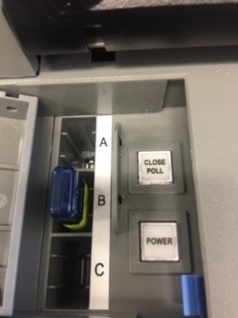
Closing the DS 200 Tabulator – P. 66
Step 1: Record the public count on the Poll Workers’ Certificate P. 71
Step 2: Open the security door and push the “Close Poll” button
Step 3: Tap the “Close Poll” button on the screen

Slide 108
Closing the DS 200 Tabulator – P. 66
Step 4: Three results tapes will print
Step 5: SIGN ALL THREE and post one copy in the poll
Other two signed result tapes returned to CBEC
Step 6: Tap “Finished” and turn off the tabulator

Slide 109
Closing Other Voting Equipment P. 65-66
Closing Electronic Poll Tablets:
Procedures on Page 65
Closing Ballot Marking Devices
Procedures on Page 65-66

Slide 110
Poll Worker Certificate – P. 71
All poll workers MUST sign
Applies only to tabulators
Beginning count from ZERO tapes
Number of votes on counter from DS 200
Ending count from results tapes
TIME MADE INACCESSIBLE

Slide 111
Departing the Poll
Follow any specific instructions from CBEC
Remove postings and collect “VOTE HERE” signs
Collect all supplies and election materials
Put the poll back in order
Seal stub boxes for transport to County Board of Election Commission
Remember to take ALL BALLOTS from the tabulators and return to CBEC
Comprehensive Checklist beginning on Page 73

Slide 112
Deliver to County Clerk
A copy of the Certificate of Election Results
One copy of tally sheets, if any
List of Voters Form
Precinct Voter Registration Lists
Voter Registration Application Forms
Other record-keeping supplies
Notes:
Delivery to County Clerk could be performed by poll workers or CBEC – varies by county and training can be adjusted accordingly.

Slide 113
Deliver to CBEC
Sealed package holding the election media sticks
and certified returns (results tapes)
Obtain a receipt
Provisional Ballots returned by two election officials
Paper ballots preserved separately & secured
Voted paper ballots in a secured container with a numbered
seal
Unused, provisional, cancelled, defective ballots
Election supplies and materials
A copy of the Certificates of Election Results
One copy of any tally sheets, if any
Other election returns
A completed poll worker guide/checklist

Slide 114
Early Voting
Additional Conditions when Conducting Early Voting

Slide 115
Early Voting
Same as Election Day, except:
Keep daily dated records of numbers of ballots cast signed by the poll workers
The Voter List form should be kept starting with the first day of early voting and signed by all poll workers who kept the list on that day
At the end of each day – secure the machines, materials, and ALL ballots
Lock up to prevent unauthorized tampering
County Clerk updates VR database within 24 hours
Notes:
A voter list form should be kept beginning with the first day of early voting and signed by all poll workers who kept the list on that day. The list should be continued on the second day of early voting with numbering of the new day’s list being a continuation of from the previous day. The new days list should be signed and attested to daily

Slide 116
Absentee Ballot Processing
This section provides instruction for election official's designated to process Absentee Ballots
Specifically, we’ll cover:
Process of Absentee Voting
Canvassing Absenting Ballots
Counting Absentee Ballots

Slide 117
Opening & Processing Absentee Ballots
Conducted by election officials BEFORE the polls close on election day
Clerk 1, while observed by another election official, opens the return (outer) envelope and verifies that the voter statement, Photo ID and the ballot (inner) envelope have been properly placed in the return envelope.
If everything is in order:
Clerk 1 reads aloud the voter’s name and precinct from the voter statement.
Clerk 2 lists the name and precinct of the voter.
The election officials compare the name, address, DOB and signature on the absentee ballot application against the voter statement.
The election officials compare the name of the bearer, agent or administrator written on the absentee ballot application to the voter statement.
The election officials compare the name and address of the bearer, agent or administrator written on the absentee ballot return envelope with the information on the voter statement.
Place the unopened inner “Ballot Only” envelope into the absentee ballot box.

Slide 118
Opening & Processing Absentee Ballots
If the voter statement and/or ID are NOT in the return envelope separate from the inner “Ballot Only” envelope:
Clerk 1 removes the inner “Ballot Only” envelope from the outer return envelope and hands it to Clerk 2.
Clerk 2 inspects the inner “Ballot Only” envelope while being observed by clerk 1 and,
Removes the voter statement and/or ID documents, if found there, from the inner “Ballot Only” envelope and hands them to Clerk 1.
Clerk 2 returns the inner “Ballot Only” envelope and any found voter statement/ID documents to Clerk 1 and Clerk 1 places the inner “Ballot Only” envelope back into the outer return envelope.
Clerk 1 reads aloud from the voter statement, and regular processing procedures (see previous slide) are followed.
Ballots processed before Election Day should be set aside until after 8:30 a.m. on Election Day

Slide 119
Validity of Absentee Ballots
A name on a voter statement that is slightly different from the way the name is stated on the absentee ballot application “compares” if all the other information (DOB, address, signature) demonstrates that it is the same person.
Addresses and Dates of birth must match.
Election officials are not handwriting experts. Reject a ballot on the basis that the signatures do not compare only if there is a distinct and easily recognizable difference between the signature on the absentee ballot application and the voter statement.
All absentee ballots must contain a form of ID (photo or document from long term care facility) unless it is from an active Duty Military voter
Certain voters may be "flagged" with a "must show ID" notation on the PVR list. If voting by absentee ballot, these "flagged" voters must include in the return envelope a copy of a current and valid photo identification or a copy of a current utility bill, bank statement, government check, paycheck, or other government document that shows the name and address of the voter. If identification is not present, the ballot is considered a provisional ballot.
If there is any doubt about the validity of a ballot, set it aside for the election commission to review.

Slide 120
Provisional Absentee Ballots
Poll watcher challenges;
Flagged voters (registered without required ID documents); and
Absentee ballots that are returned without containing a copy of one of the designated forms of ID will become Provisional
Absentee ballots delivered by a bearer/agent/administrator for which the name and address of the bearer/agent/administrator written by the county clerk on the return envelope, or the bearer/agent/administrator's name on the absentee ballot application does not match the information contained in the voter statement become Provisional.
If an absentee ballot becomes provisional, the absentee ballot clerk will:
Place the return envelope and everything that is inside it into a provisional voter envelope;
Record on the provisional voter envelope the reason the absentee ballot was made provisional, including the reason the ballot was challenged, if any; and
Set the provisional ballots aside for consideration by the election commission.

Slide 121
Counting Absentee Ballots
After processing all the absentee ballots, the absentee ballot election officials shake the ballot box containing the inner “Ballot Only” envelopes thoroughly to mix the ballots.
When it is time to count the ballots, election officials must:
Open the inner “Ballot Only” envelopes;
Count any write-in votes first; and
Count the remaining ballots by hand or electronic tabulating device at the discretion of the election commission.
Reject any ballot if:
It comes in a bulk mailing from someone other than an administrator of a long-term care facility;
No voter statement is found in the return envelope or the ballot envelope;
If the election commission finds that the name, date of birth, address or signature on the voter statement do not compare to the corresponding information on the absentee ballot application;
The absentee ballot was cast by a voter who dies before the polls open on election day if it is postmarked, delivered by a bearer, agent or administrator, or, in the case of an active duty “armed services” voter, executed after the date the voter died;
If the return envelope indicates the ballot was returned by a bearer, agent or administrator but the voter has not authorized a bearer/agent/administrator on the voter statement.

Slide 122
And Remember:
The outer envelopes of absentee ballots may be opened one week before Election Day so that the election officials may begin processing the absentee ballot paperwork
Processing of absentee ballots secrecy (inner) envelopes may not begin prior to 8:30 a.m. on election day.
Absentee ballots on hand (and early votes) must be counted before the polls close on election day and the initial count reported to the Secretary of State as soon as practical after 7:30 p.m.
Notes:
The times and locations for the newly created early canvassing and processing
must still be included in the public notice required in A.C.A. §7-5-202

Slide 123
STATE BOARD OF ELECTION COMMISSIONERS
501 Woodlane Street – Suite 122 South
Little Rock, Arkansas 72201
(501)682-1834 or (800)411-6996
Fax: (501)682-1782
info.sbec@arkansas.gov
www.arkansas.gov/sbec

